Slide 1
Final Project
Jax Lehmann, Chibuzo Ifezue, Vincent Guminski"

Slide 2
Questions to be Answered
What is the average number of goals scored each match in the Premiere League for the Home teams? (Goals - Numeric Discrete. Home Teams- Categorical.)
How does the average number of fouls committed differ between Home and Away teams/does being Home or Away impact number of fouls? (Fouls - Numeric Continuous. Home/Away Teams - Categorical.)

Slide 3
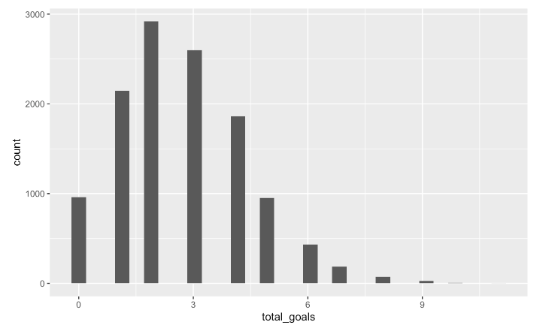
Using a Histogram!

Slide 4
Histogram Analysis
The Histogram gives us the total number of goals between Home and Away.
This does not give conclusive information about the question we asked, being “What is the average number of goals scored for the Home team in the Premiere League?”

Slide 5
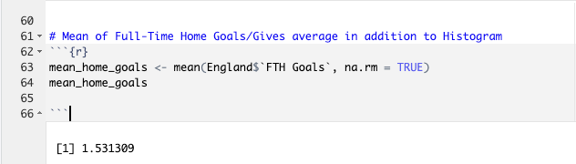
Better Approach!
It would be better to calculate the mean by piping in Home goals with mean!
The average, by mean, for Home goals is roughly 1.5 goals scored each game.

Slide 6
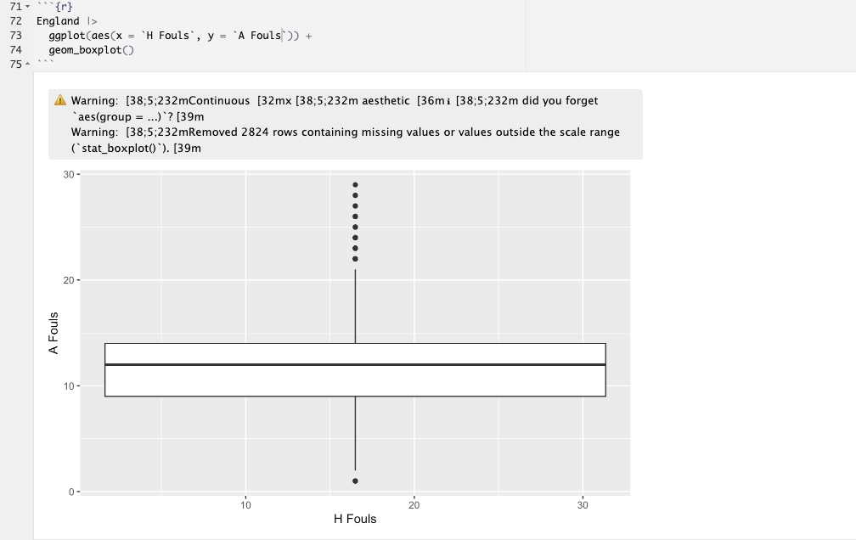
Fouls - Home vs Away Boxplot

Slide 7
Better Approach!
Since both variables are numeric discrete, a box plot does not give the best information.
Better to use a scatter plot!

Slide 8
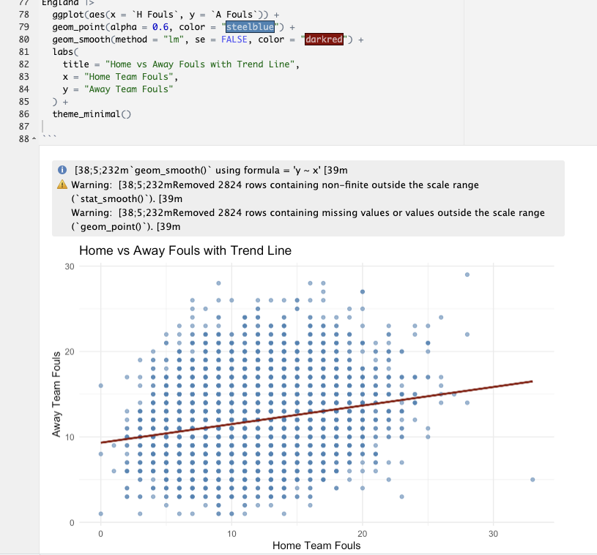

Slide 9
Reading the plot
Visually, we cannot notice much of a trend with Home and Away fouls comparatively, as the scatterplot is very clustered.
However, the trend seems that the more fouls committed via. one team directly has an effect on the other.
This is not the question we are trying to answer, so that data can be ignored. But if we wanted more input on that specific data, we could maybe ask something like “Are teams more aggressive or passive in conjunction with the opposition’s nature?” Then conduct further linear testing for a more conclusive answer.
To answer our question, we can run ANOVA.

Slide 10
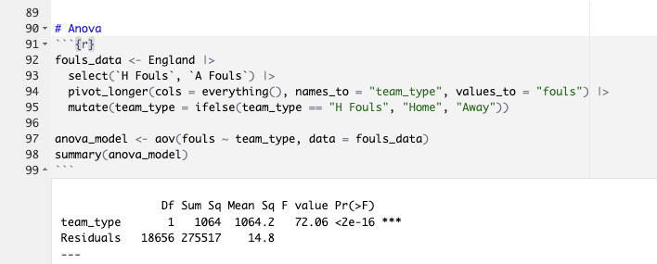
ANOVA Testing

Slide 11
Reading our Findings
Null hypothesis - Home and Away teams commit similar number of fouls.
Alternative hypothesis - One side commits more fouls than the other.
P-value = <2e-16 (essentially 0)
Our findings mean that we can reject the null hypothesis, since the P-value is less than 0.05!
However, this does not tell us which side is committing more fouls.
Can compare means to see the side committing more fouls.

Slide 12
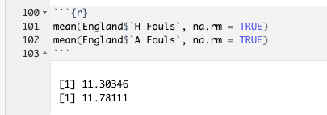
Mean Comparison
Home mean - 11.3
Away mean - 11.78

Slide 13
Interpreting the means!
11.78 (Away) compared to 11.30 (Home) does not seem like a big difference, yet our ANOVA was statistically significant! What gives?
This is because statistically significant does not always mean it is practically significant.
This specific data set has thousands upon thousands of variables as well as over 25 unique variables.
Whilst there is a significant difference, there is NOT a practical difference.

Slide 14
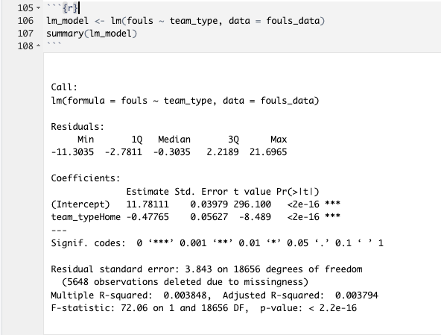
Linear Model

Slide 15
Interpreting the Linear Model
R^2 is only 0.003844 meaning team type only has a 0.38 variance in fouls.
Home teams commit 0.48 less fouls than Away teams.
P-value is statistically significant and small.
However, as previously mentioned, this is not practically significant.

Slide 16
Conclusion (ANSWERS)
What is the average number of goals scored each match in the Premiere League for the Home teams? The average, by mean, for Home Goals is roughly 1.5 goals scored each game.
How does the average number of fouls committed differ between Home and Away teams/does being Home or Away impact number of fouls? P-value = <2e-16 (essentially 0) and less than 0.05. R^2 is only 0.003844 meaning team type only has a 0.38 variance in fouls. Home teams commit 0.48 less fouls than Away teams. There is in fact a statistically significant difference between Home and Away fouls that IS NOT practically significant.

